Slide 1
Digital Scoreboard 2016:
Cyprus

Slide 2
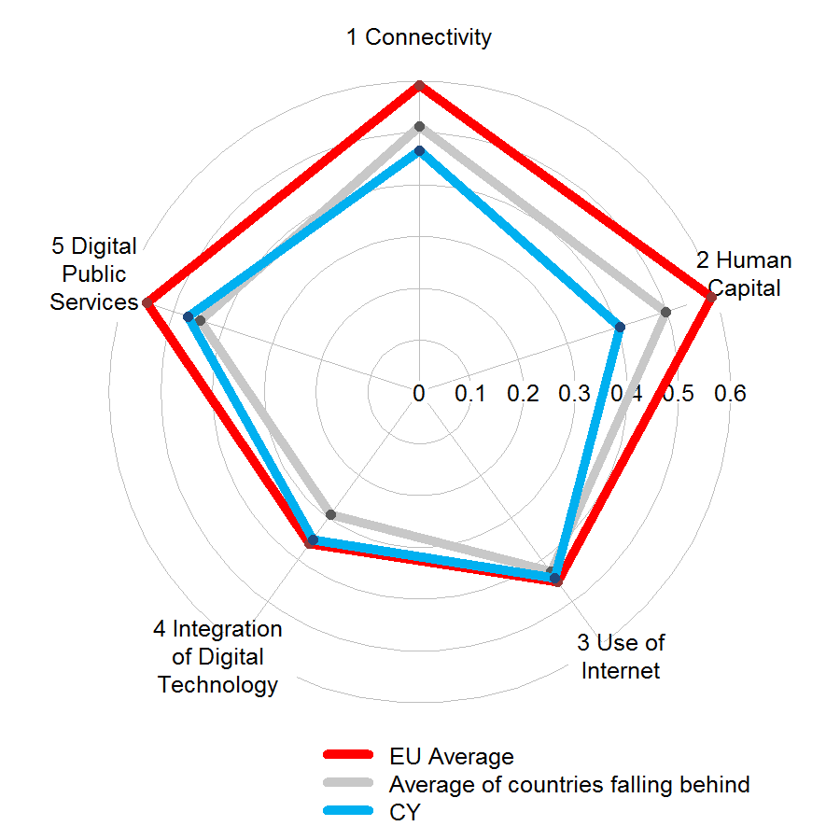
Cyprus's performance in the DESI 2016
Cyprus ranks 23 among EU countries. It is part of the group of countries that are falling behind.

Slide 3
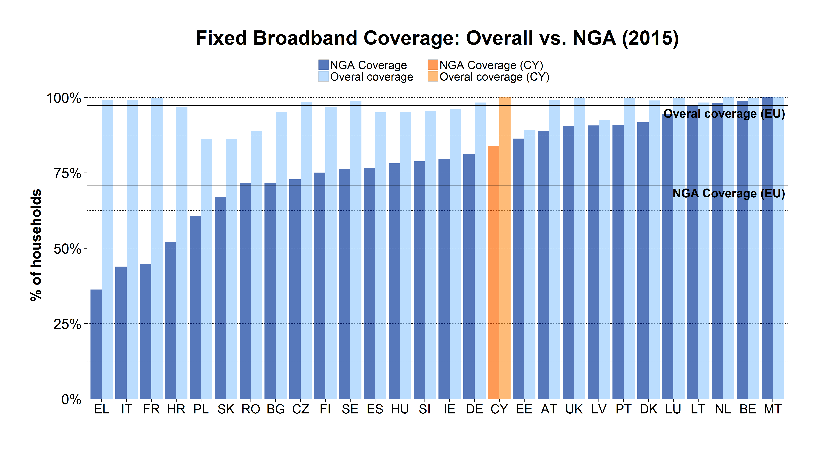
Connectivity: Fixed Broadband Coverage
In Cyprus, fixed broadband is available to 100% of households (97% in the EU). NGA connections are available to 84% of Cypriot households (71% of European households). Source: Broadband coverage in Europe, studies for the EC by IHS and Valdani, Vicari & Associati (SMART 2013/0054)

Slide 4
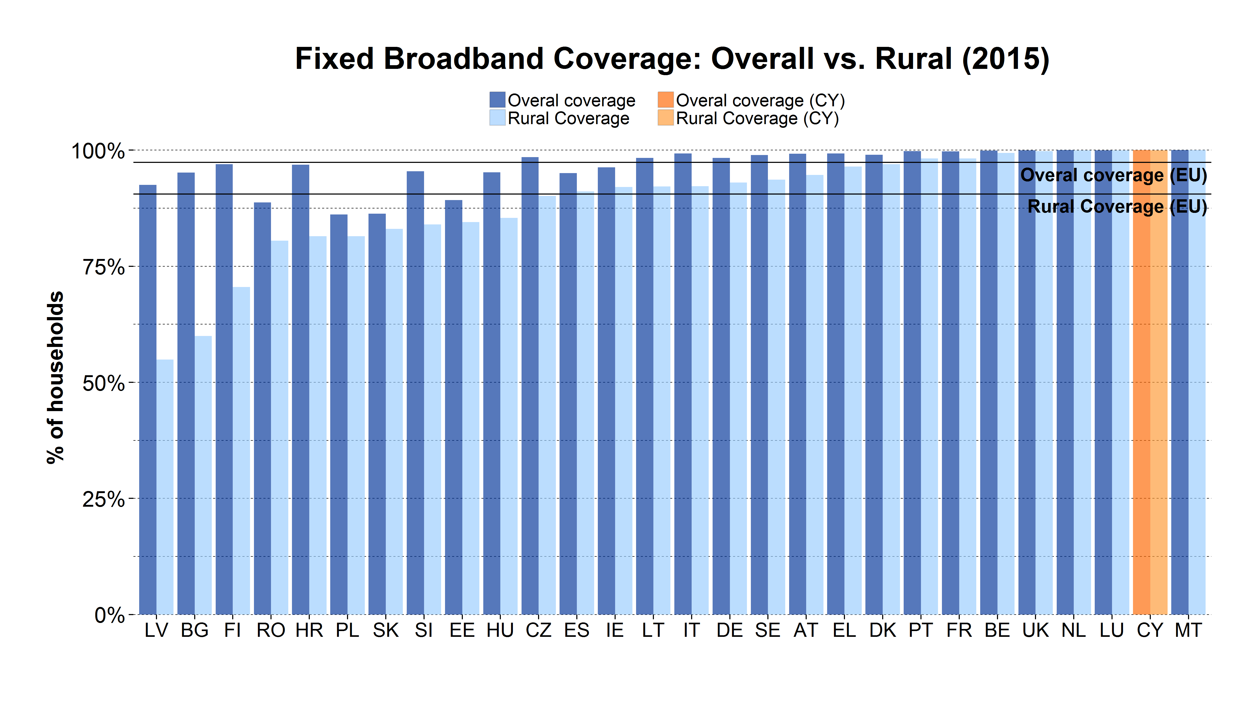
Connectivity: Rural Fixed Broadband Coverage
In Cyprus fixed broadband connections are available to 100% of households in rural areas (91% of european households in rural areas). Source: Broadband coverage in Europe, studies for the EC by IHS and Valdani, Vicari & Associati (SMART 2013/0054)

Slide 5
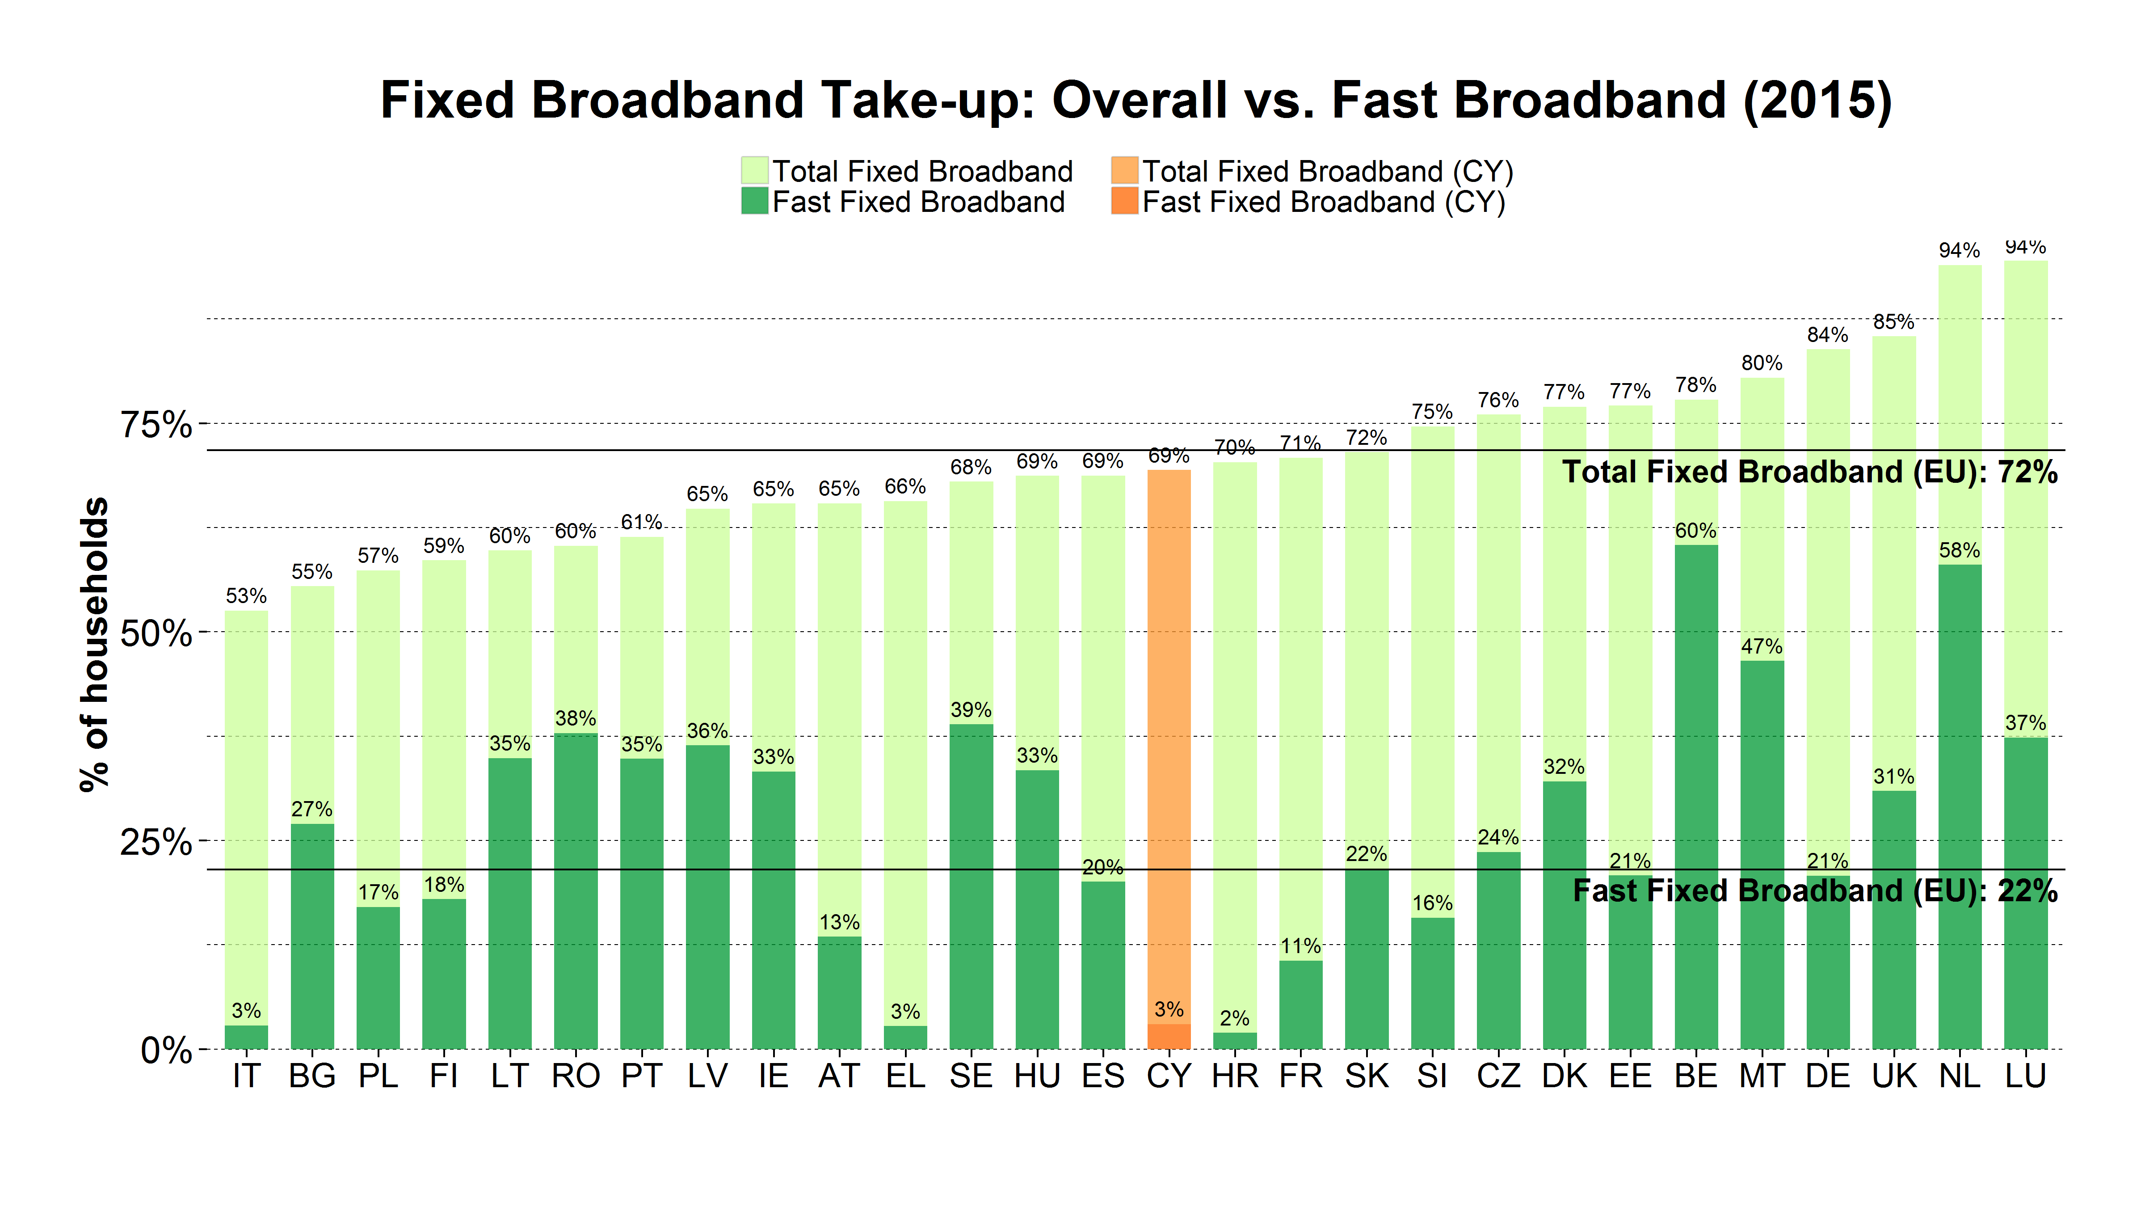
Connectivity: Fixed Broadband Take-up
69% of Cypriot households subscribe to fixed broadband (72% in the EU), and 4.3% of those subscriptions are to a fast* connection (3% of Cypriot households). 30% of EU broadband subscriptions are to a fast* connection (22% of EU households). Source: Eurostat and Electronic communications market indicators collected by Commission services, through National Regulatory Authorities, for the Communications Committee (COCOM) * A broadband connection is considered to be a fast connection when it allows for donwload speeds above 30 Mbps.

Slide 6
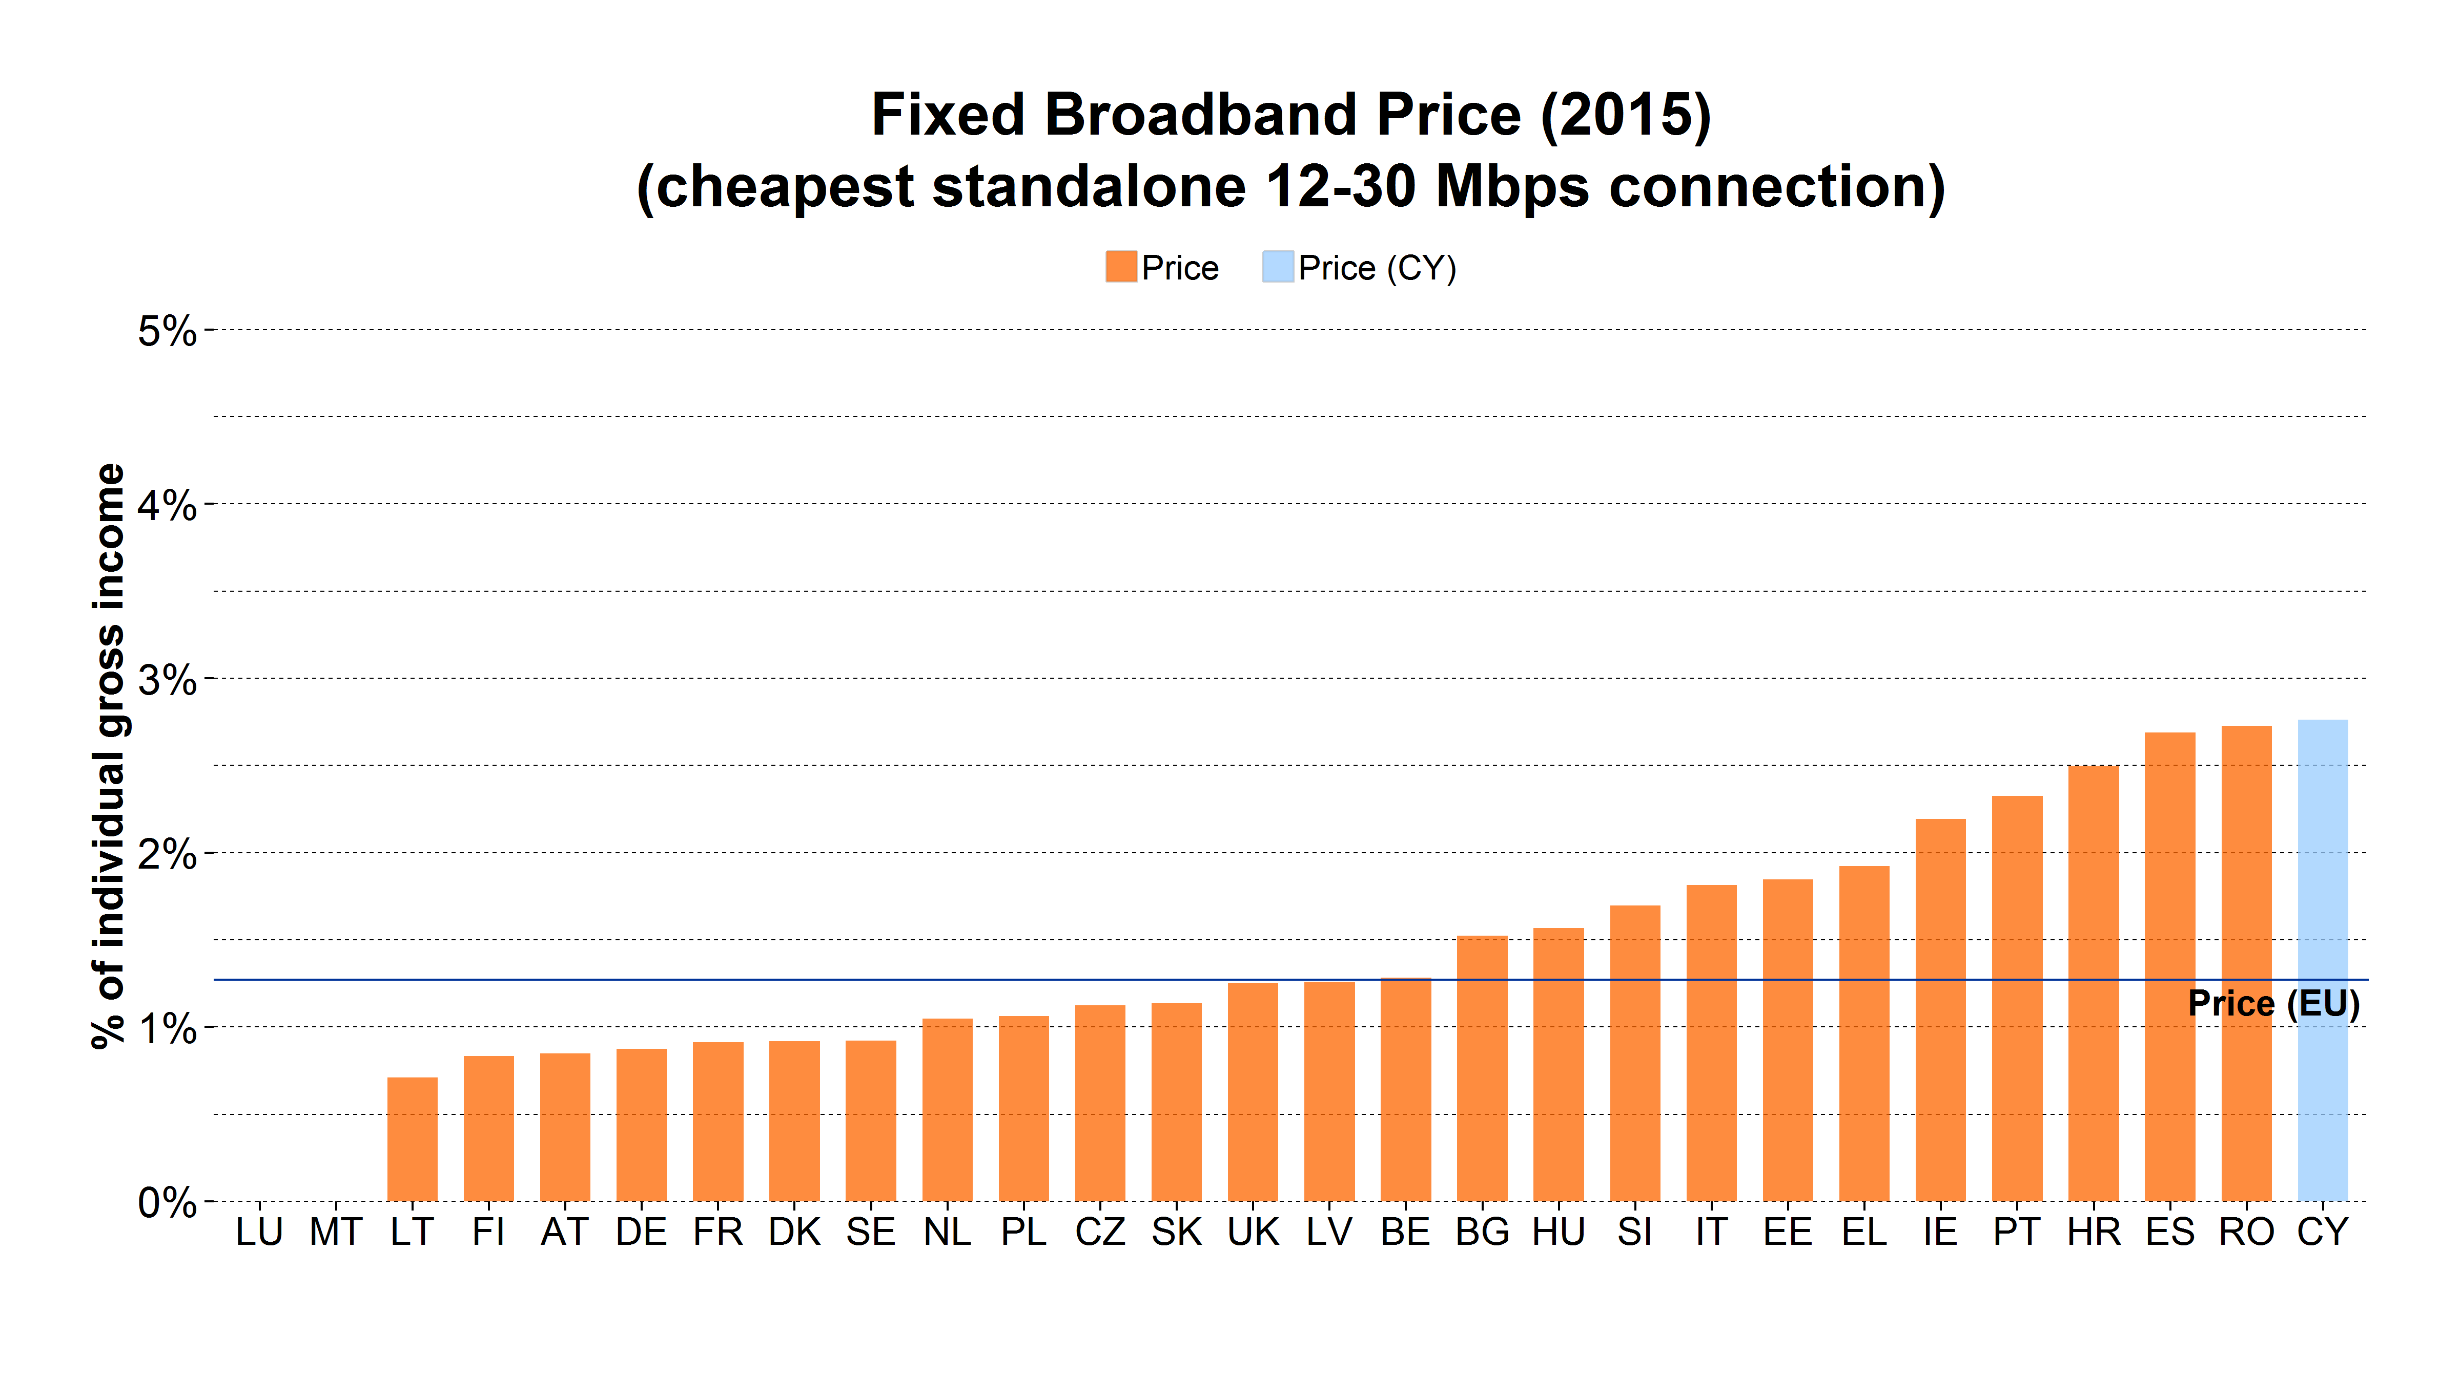
Connectivity: Fixed Broadband Price
In Cyprus the cheapest fixed (internet only) broadband connection allowing for speeds of 12-30Mbps costs 2.8% of the average individual income (overall in the EU it costs 1.3%). Sources: (access cost) Broadband Internet Access Cost (BIAC), annual studies for the EC realised by Van Dijk; (income) real adjusted gross disposable income of households per capita (Eurostat: tec00113);

Slide 7
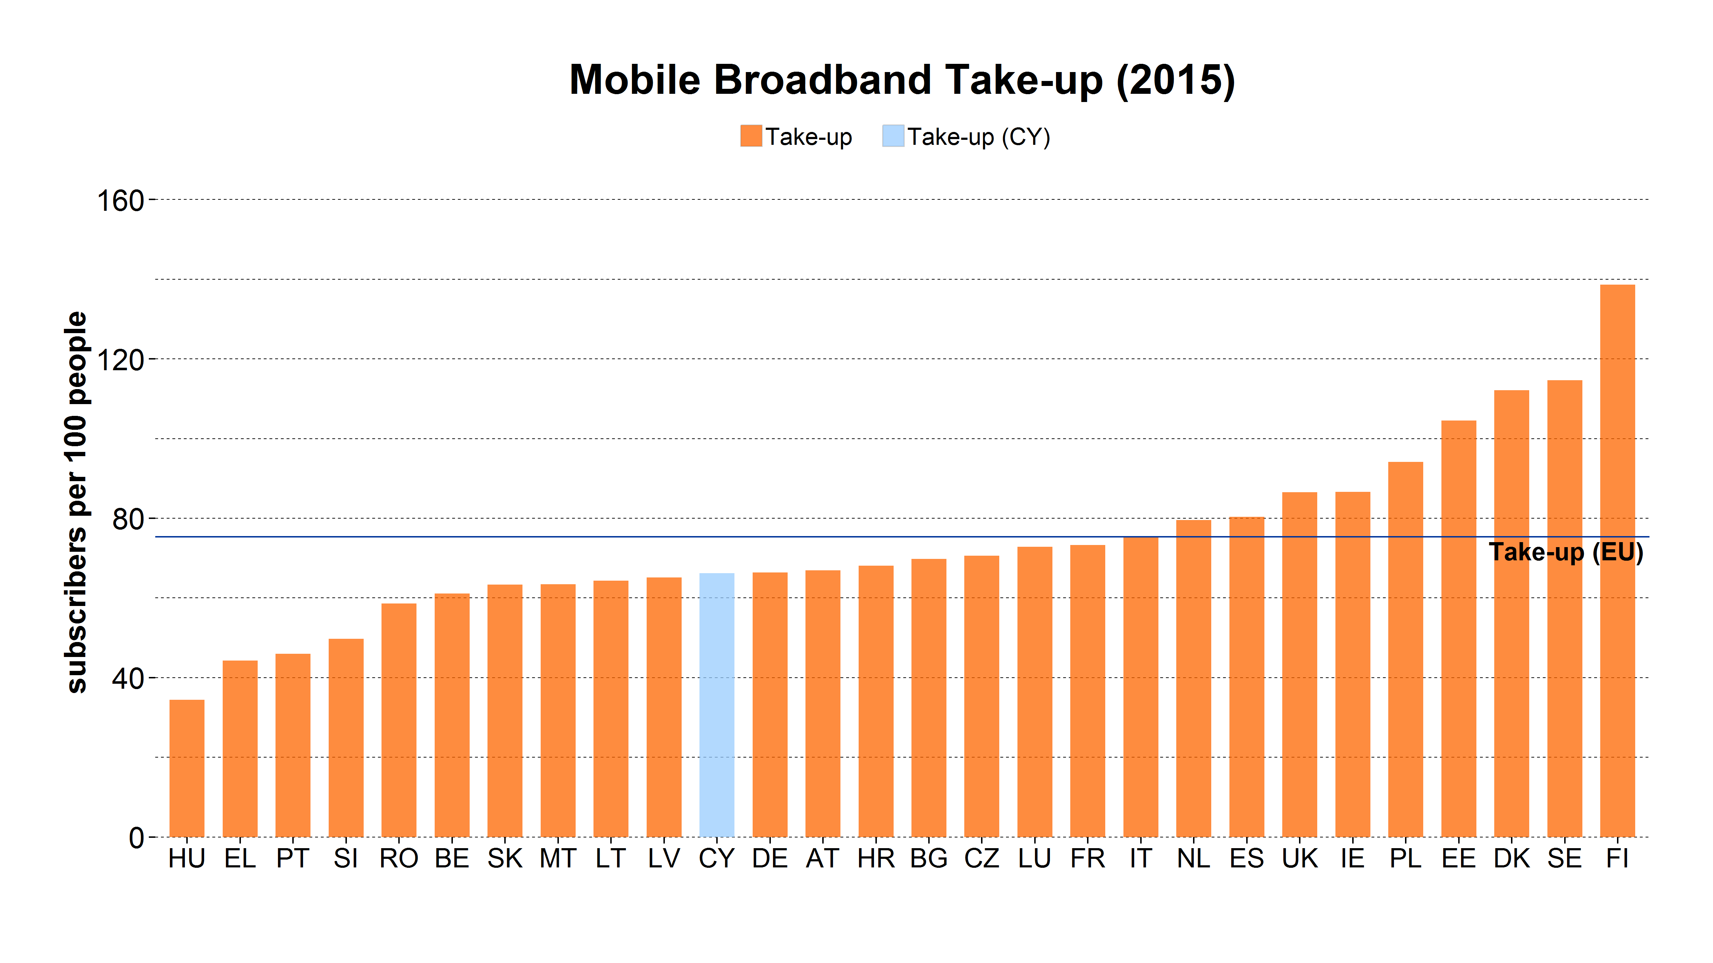
Connectivity: Mobile Broadband Take-up
In Cyprus there are 66 subscriptions to mobile broadband per each 100 people (75 in the EU) Source: Electronic communications market indicators collected by Commission services, through National Regulatory Authorities, for the Communications Committee (COCOM)

Slide 8
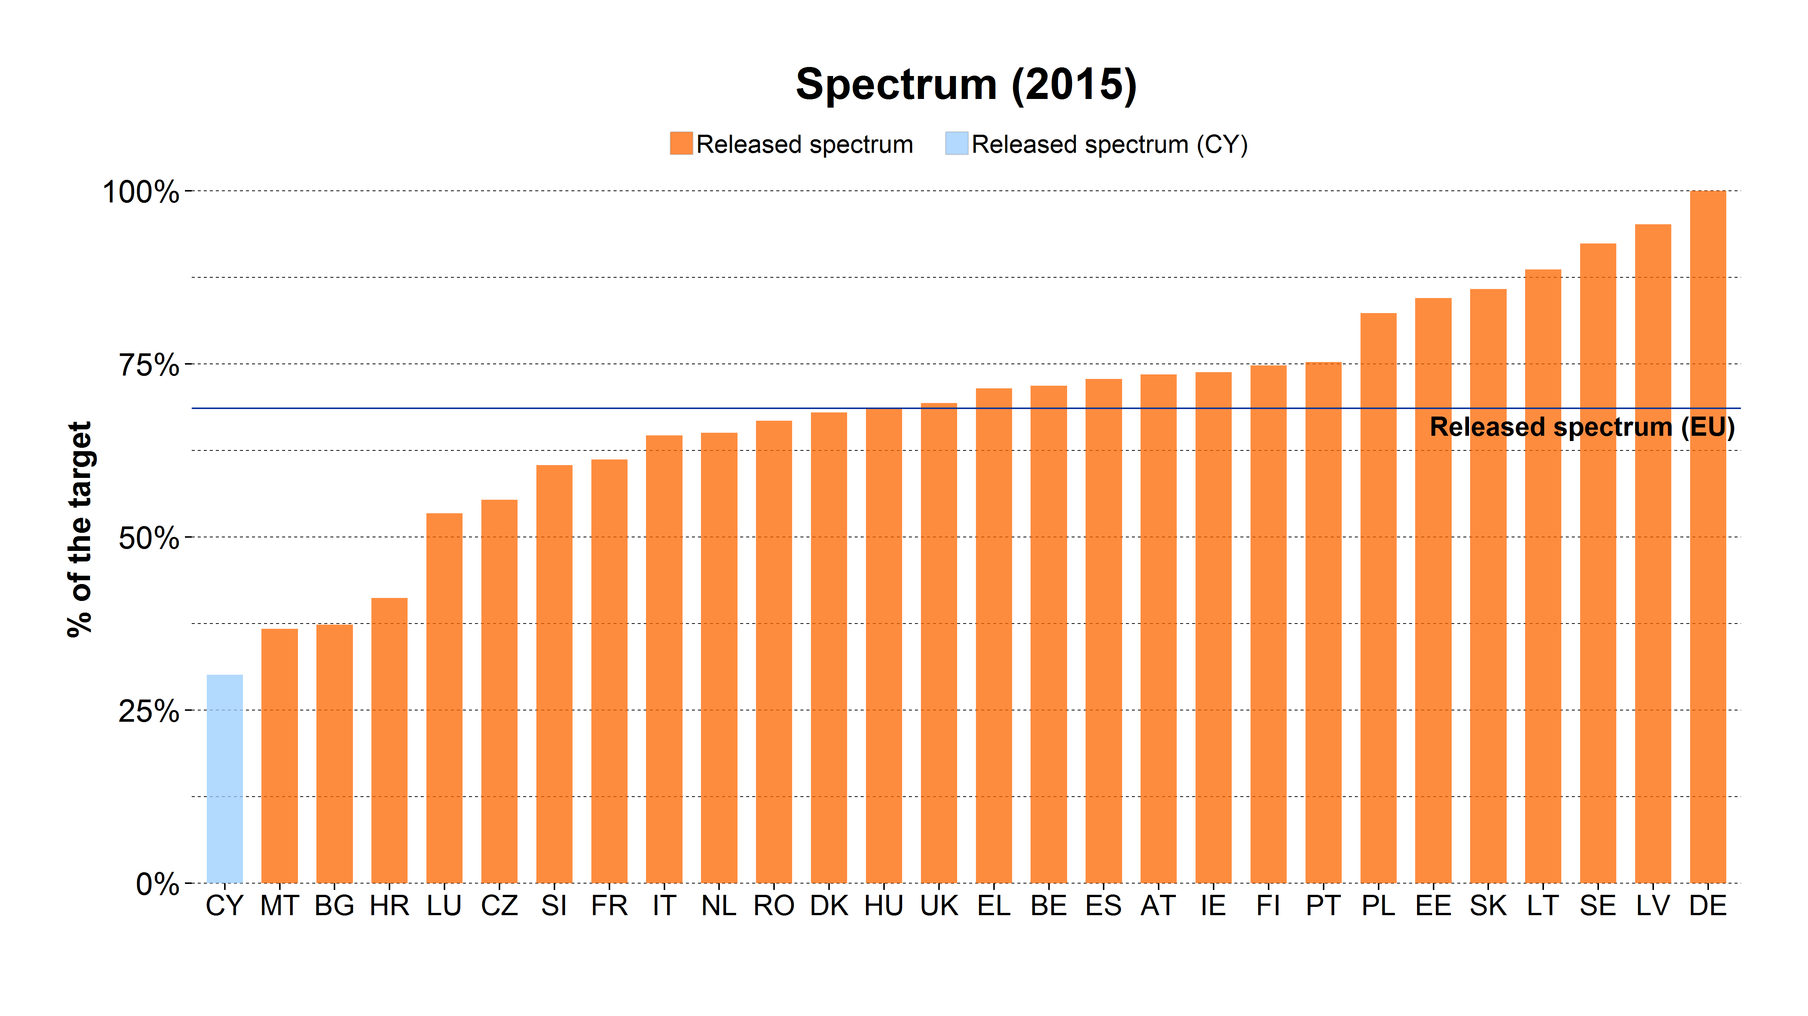
Connectivity: Spectrum
Cyprus has reached 30% of the EU goal for spectrum to be harmonised for use in mobile Broadband. In the EU as a whole 69% of the goal has been reached. Source: European Commission Services

Slide 9
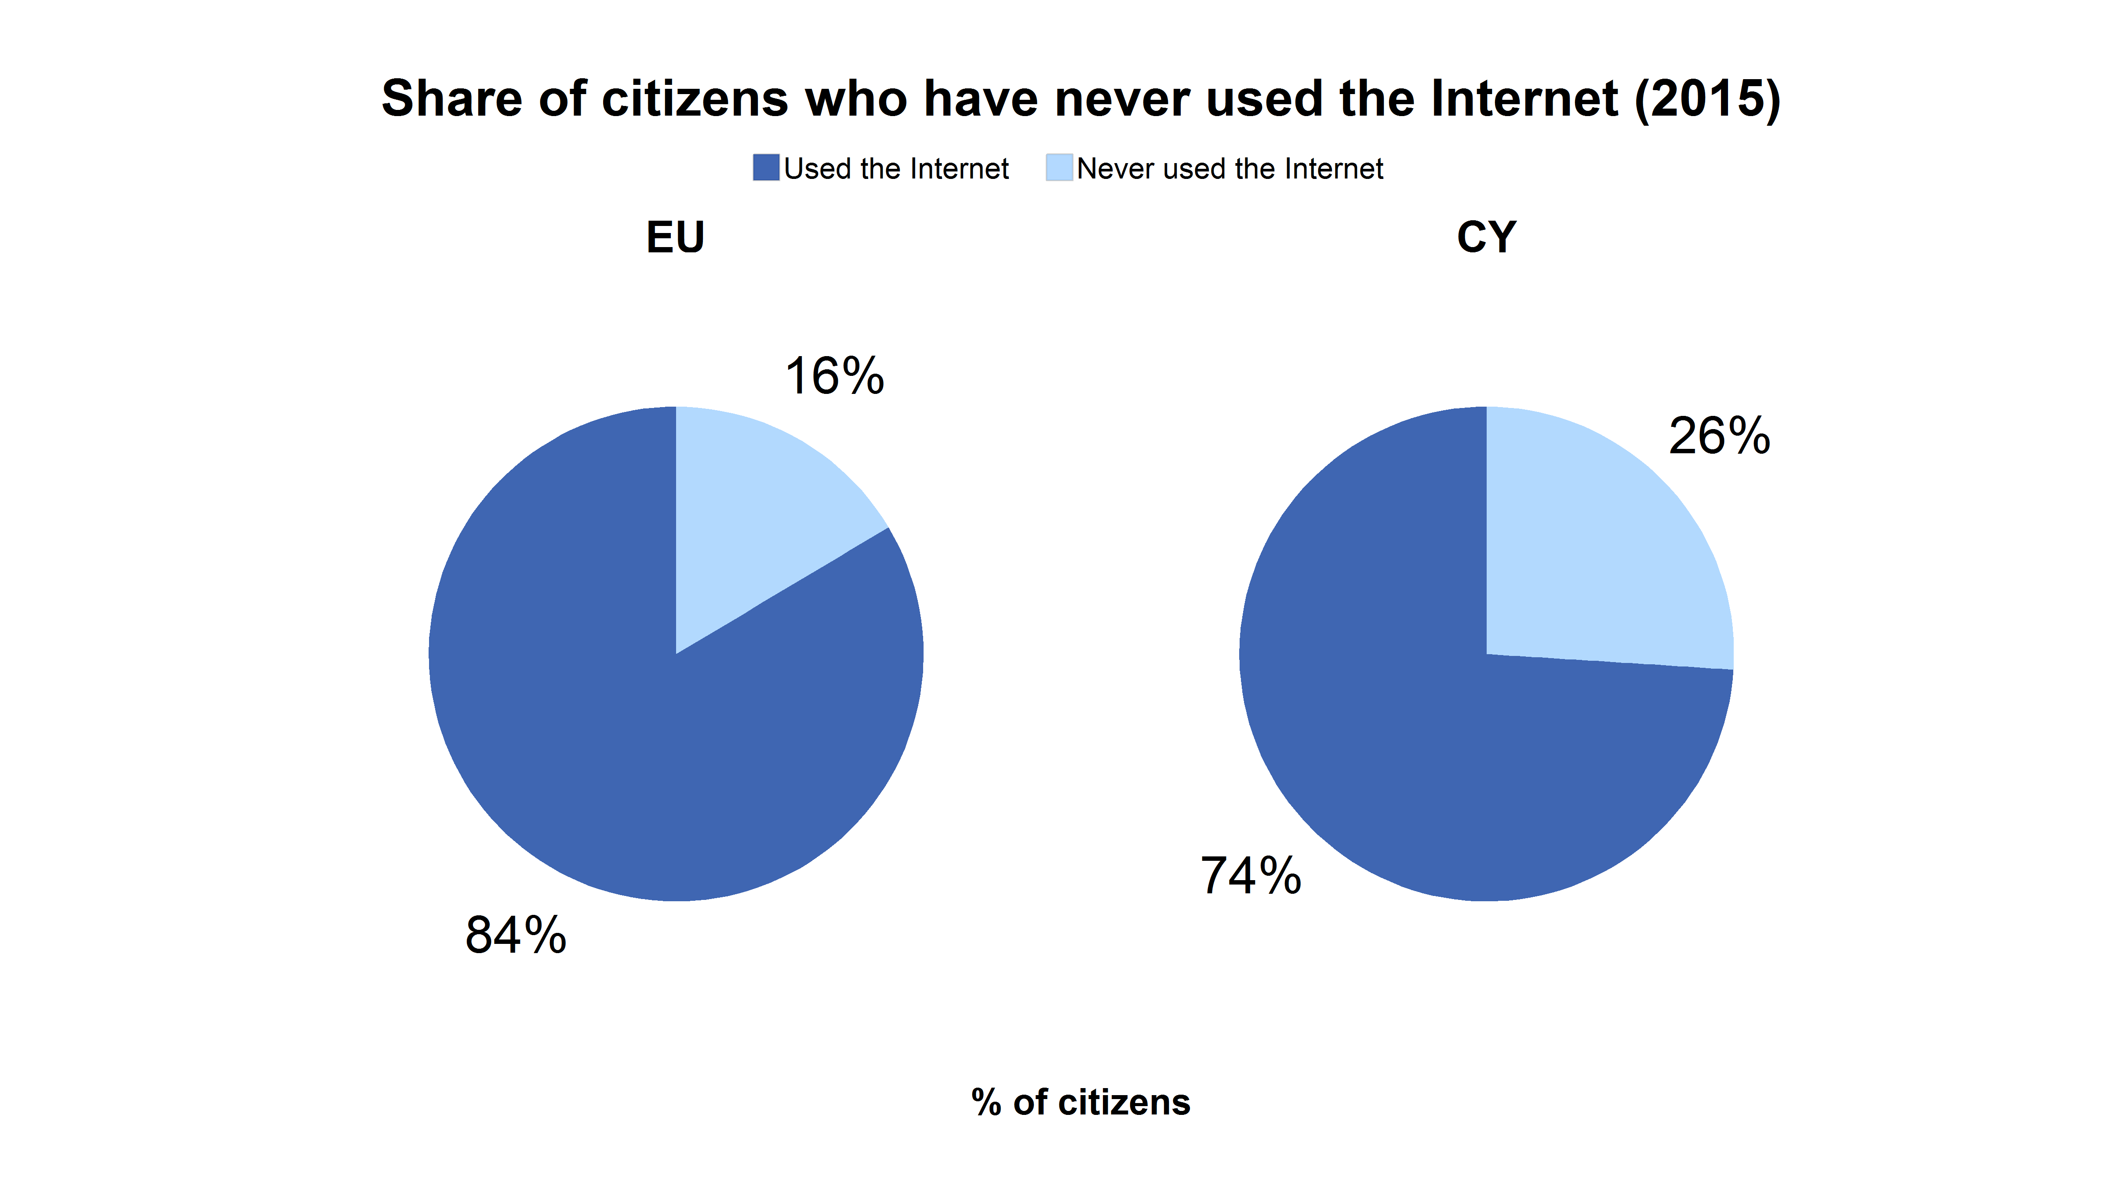
Human Capital: Internet Users
26% of Cypriots have never used the internet (16% in the EU) Source: Eurostat - Community survey on ICT usage in Households and by Individuals

Slide 10
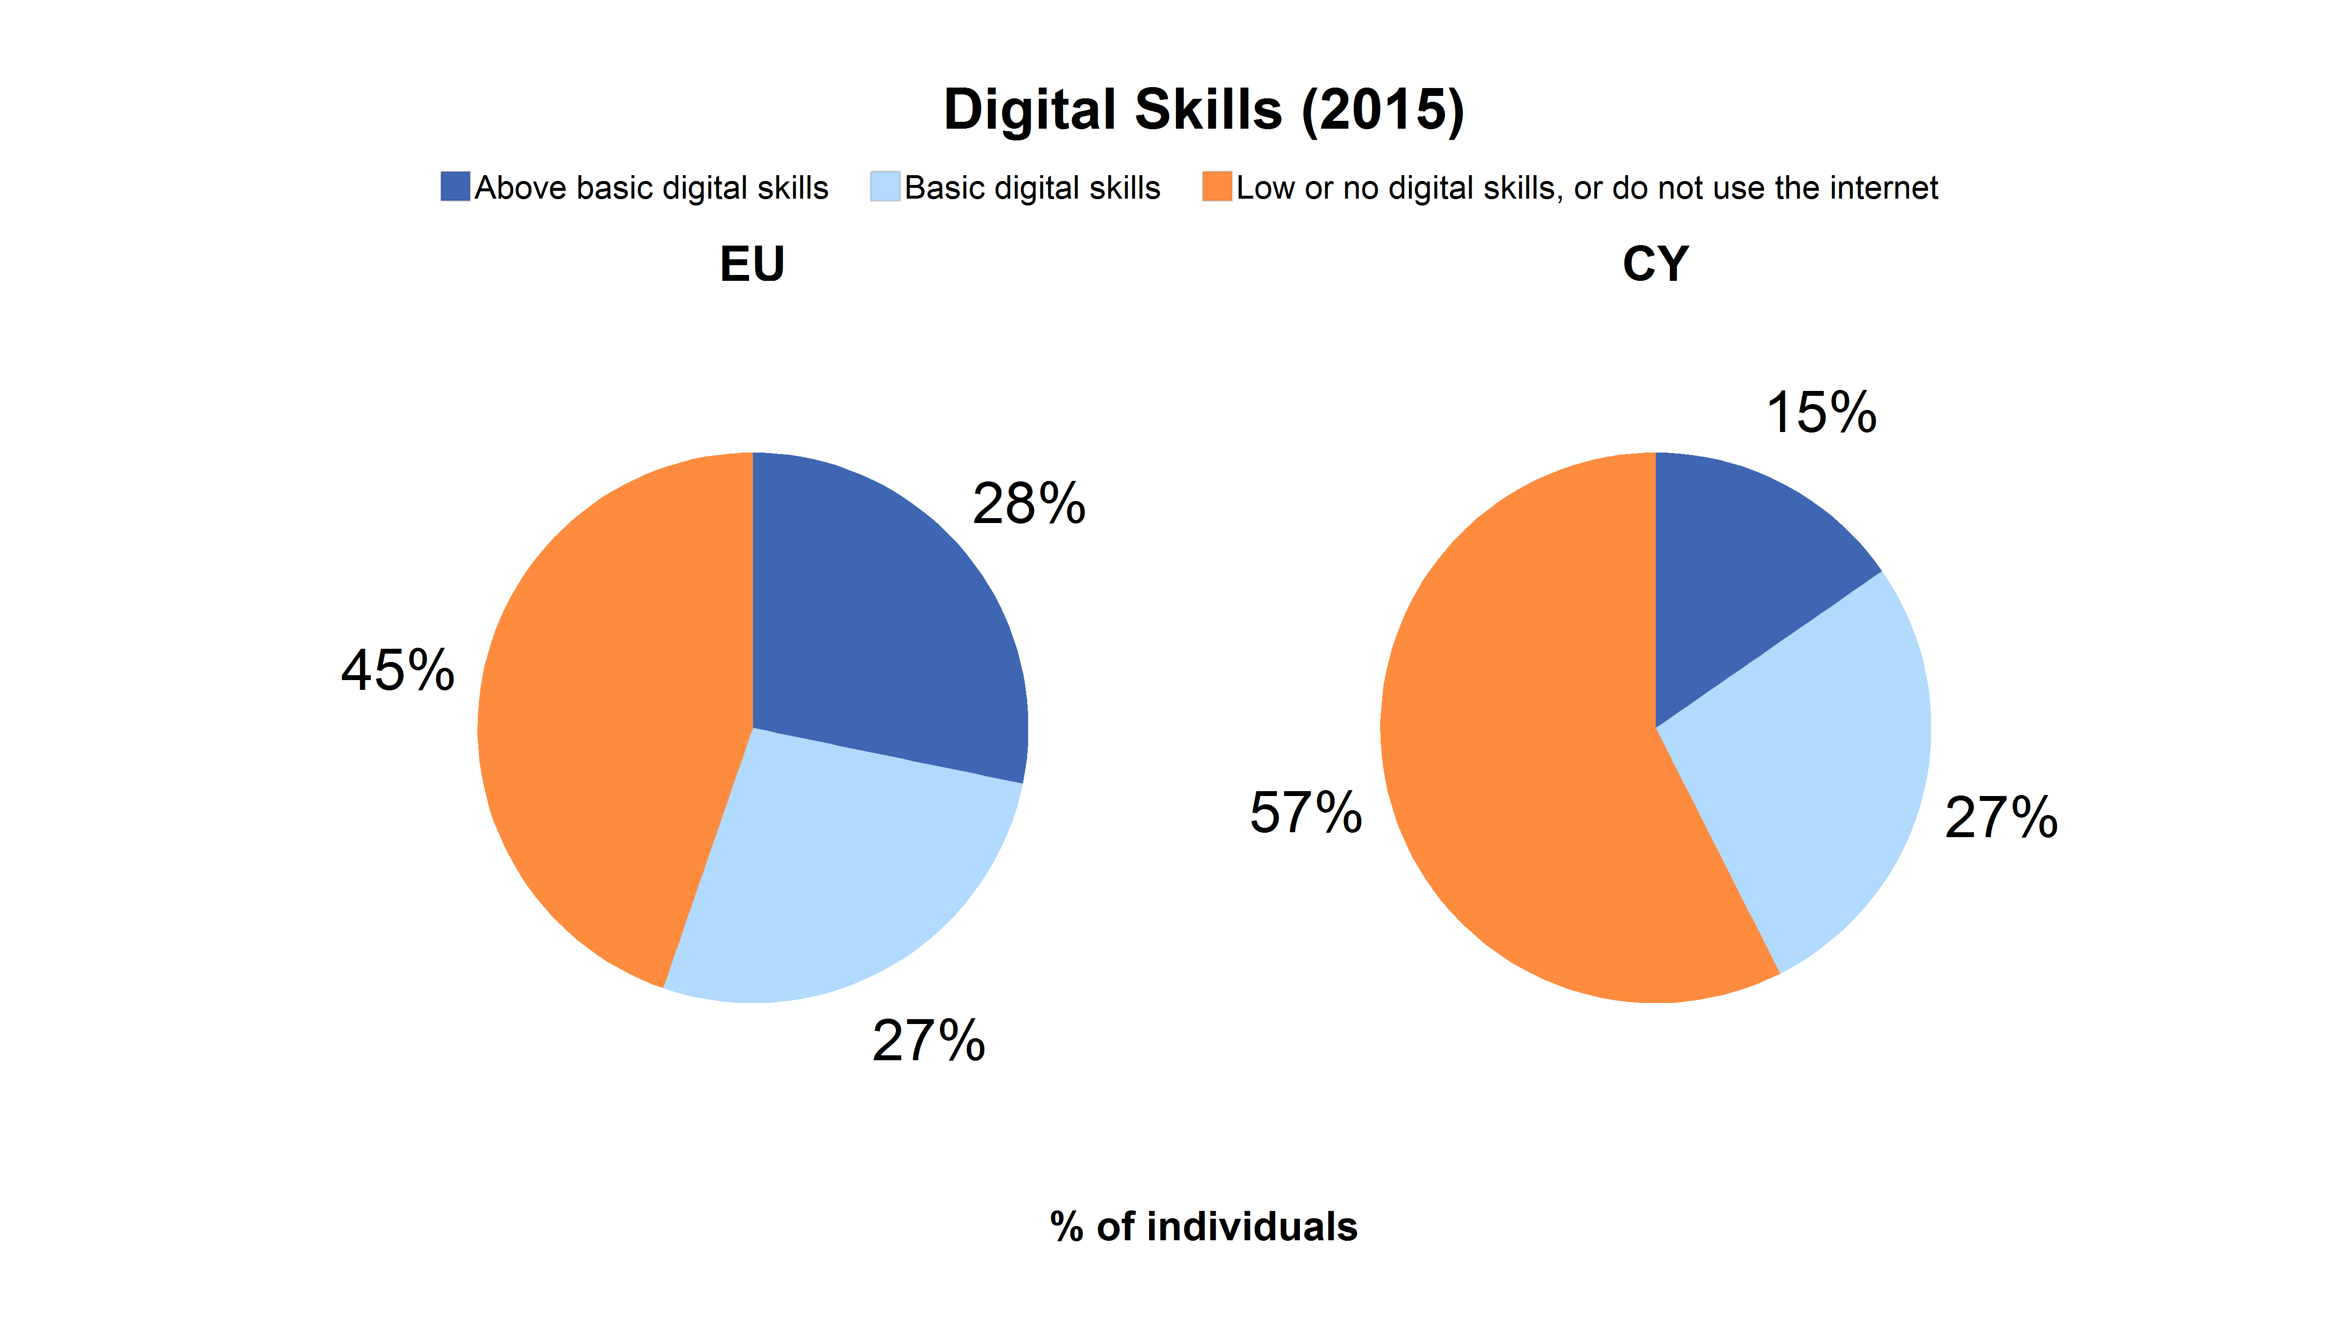
Human Capital: Digital Skills
In Cyprus 27% of citizens have basic digital skills (27% in the EU) and 15% have above basic digital skills (28% in the EU) Source: Eurostat - Community survey on ICT usage in Households and by Individuals

Slide 11
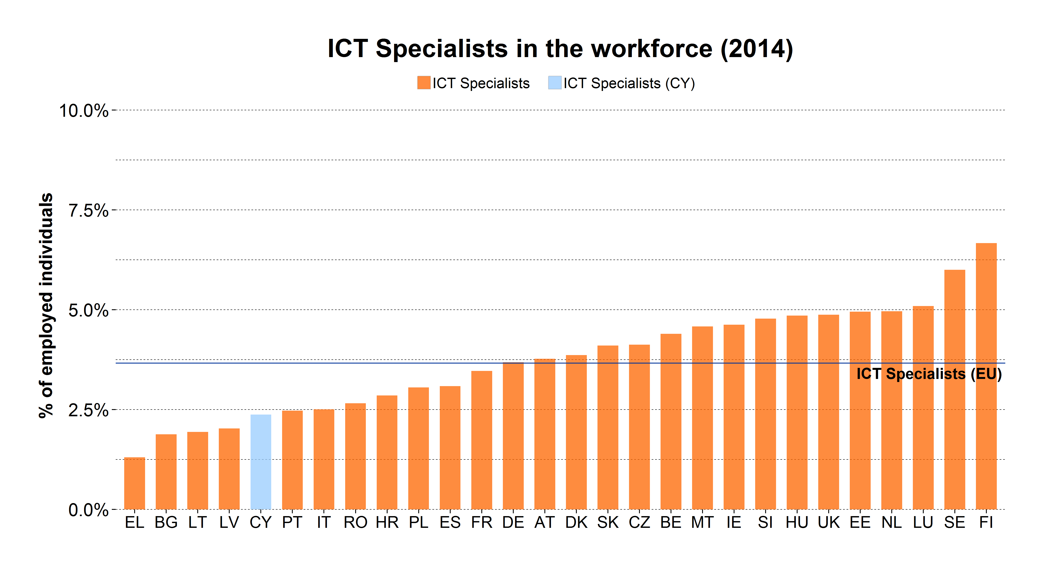
Human Capital: ICT Specialists in the workforce
In Cyprus ICT Specialists account for 2.4% of the workforce (3.7% in the EU). Source: Eurostat - Labour force survey

Slide 12
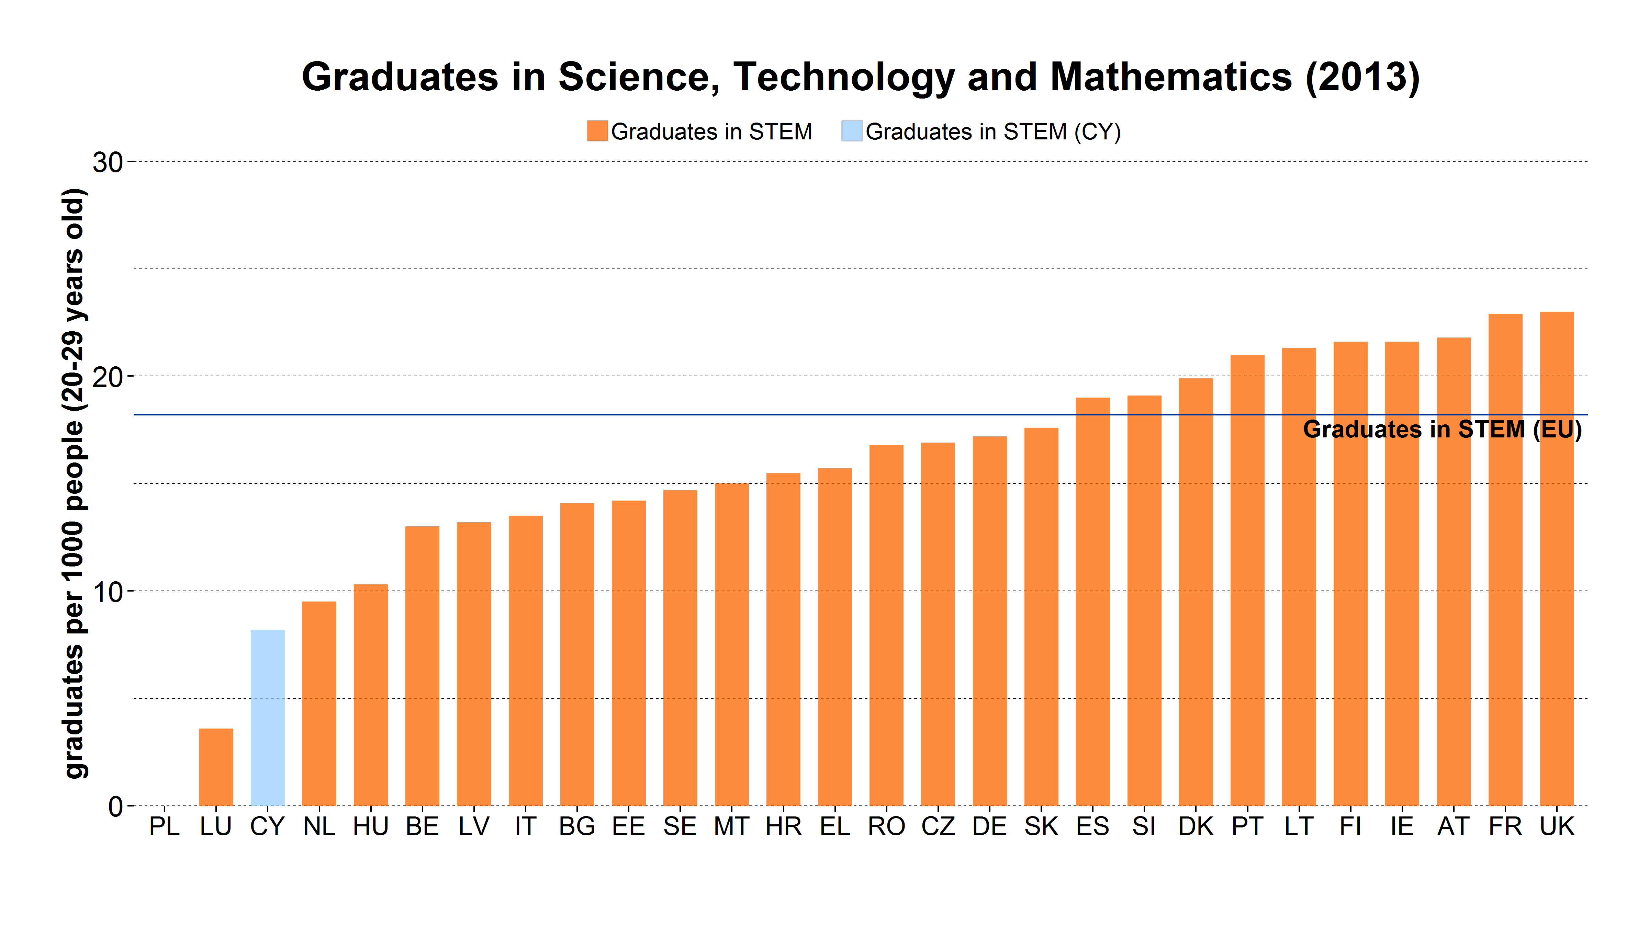
Human Capital: Graduates in STEM (Science, Technology and Mathematics)
Cyprus has 8.2 graduates in STEM per each 1000 people aged 20-29 years old (18 in the EU). Source: Eurostat - Science and technology graduates by sex

Slide 13
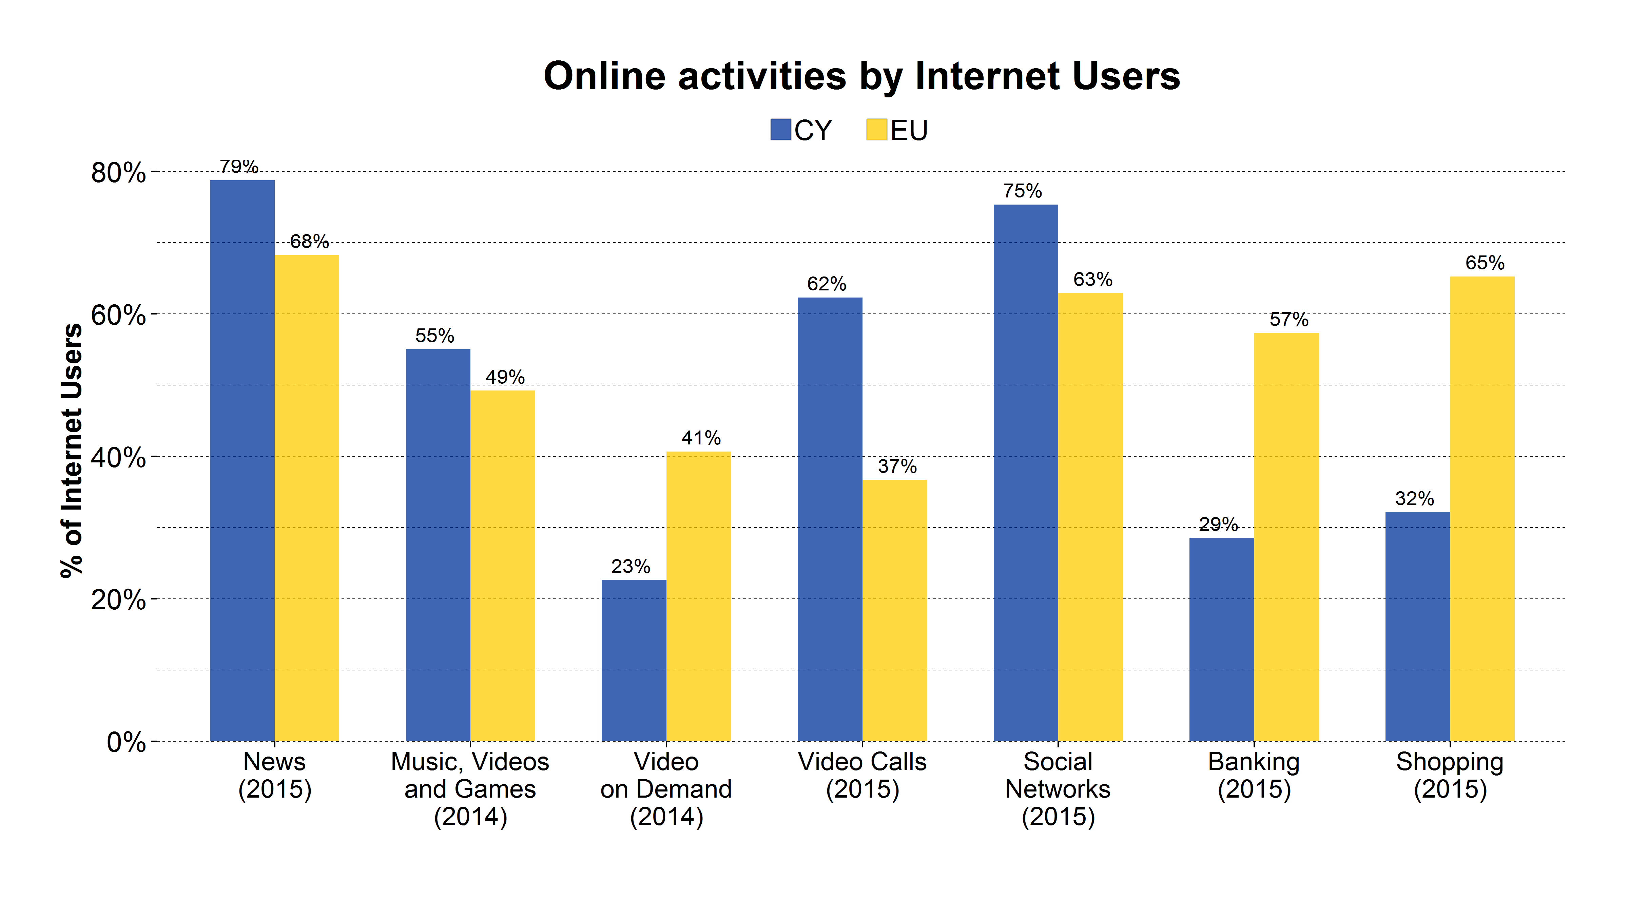
Use of Internet
Cypriots, much like European citizens in general, perform a diverse set of activities online. They use the Internet to consume content and media, to communicate, and to perform transactions. Source: Eurostat - Community survey on ICT usage in Households and by Individuals; IHS Technology databases - TV Media Intelligence Service.

Slide 14
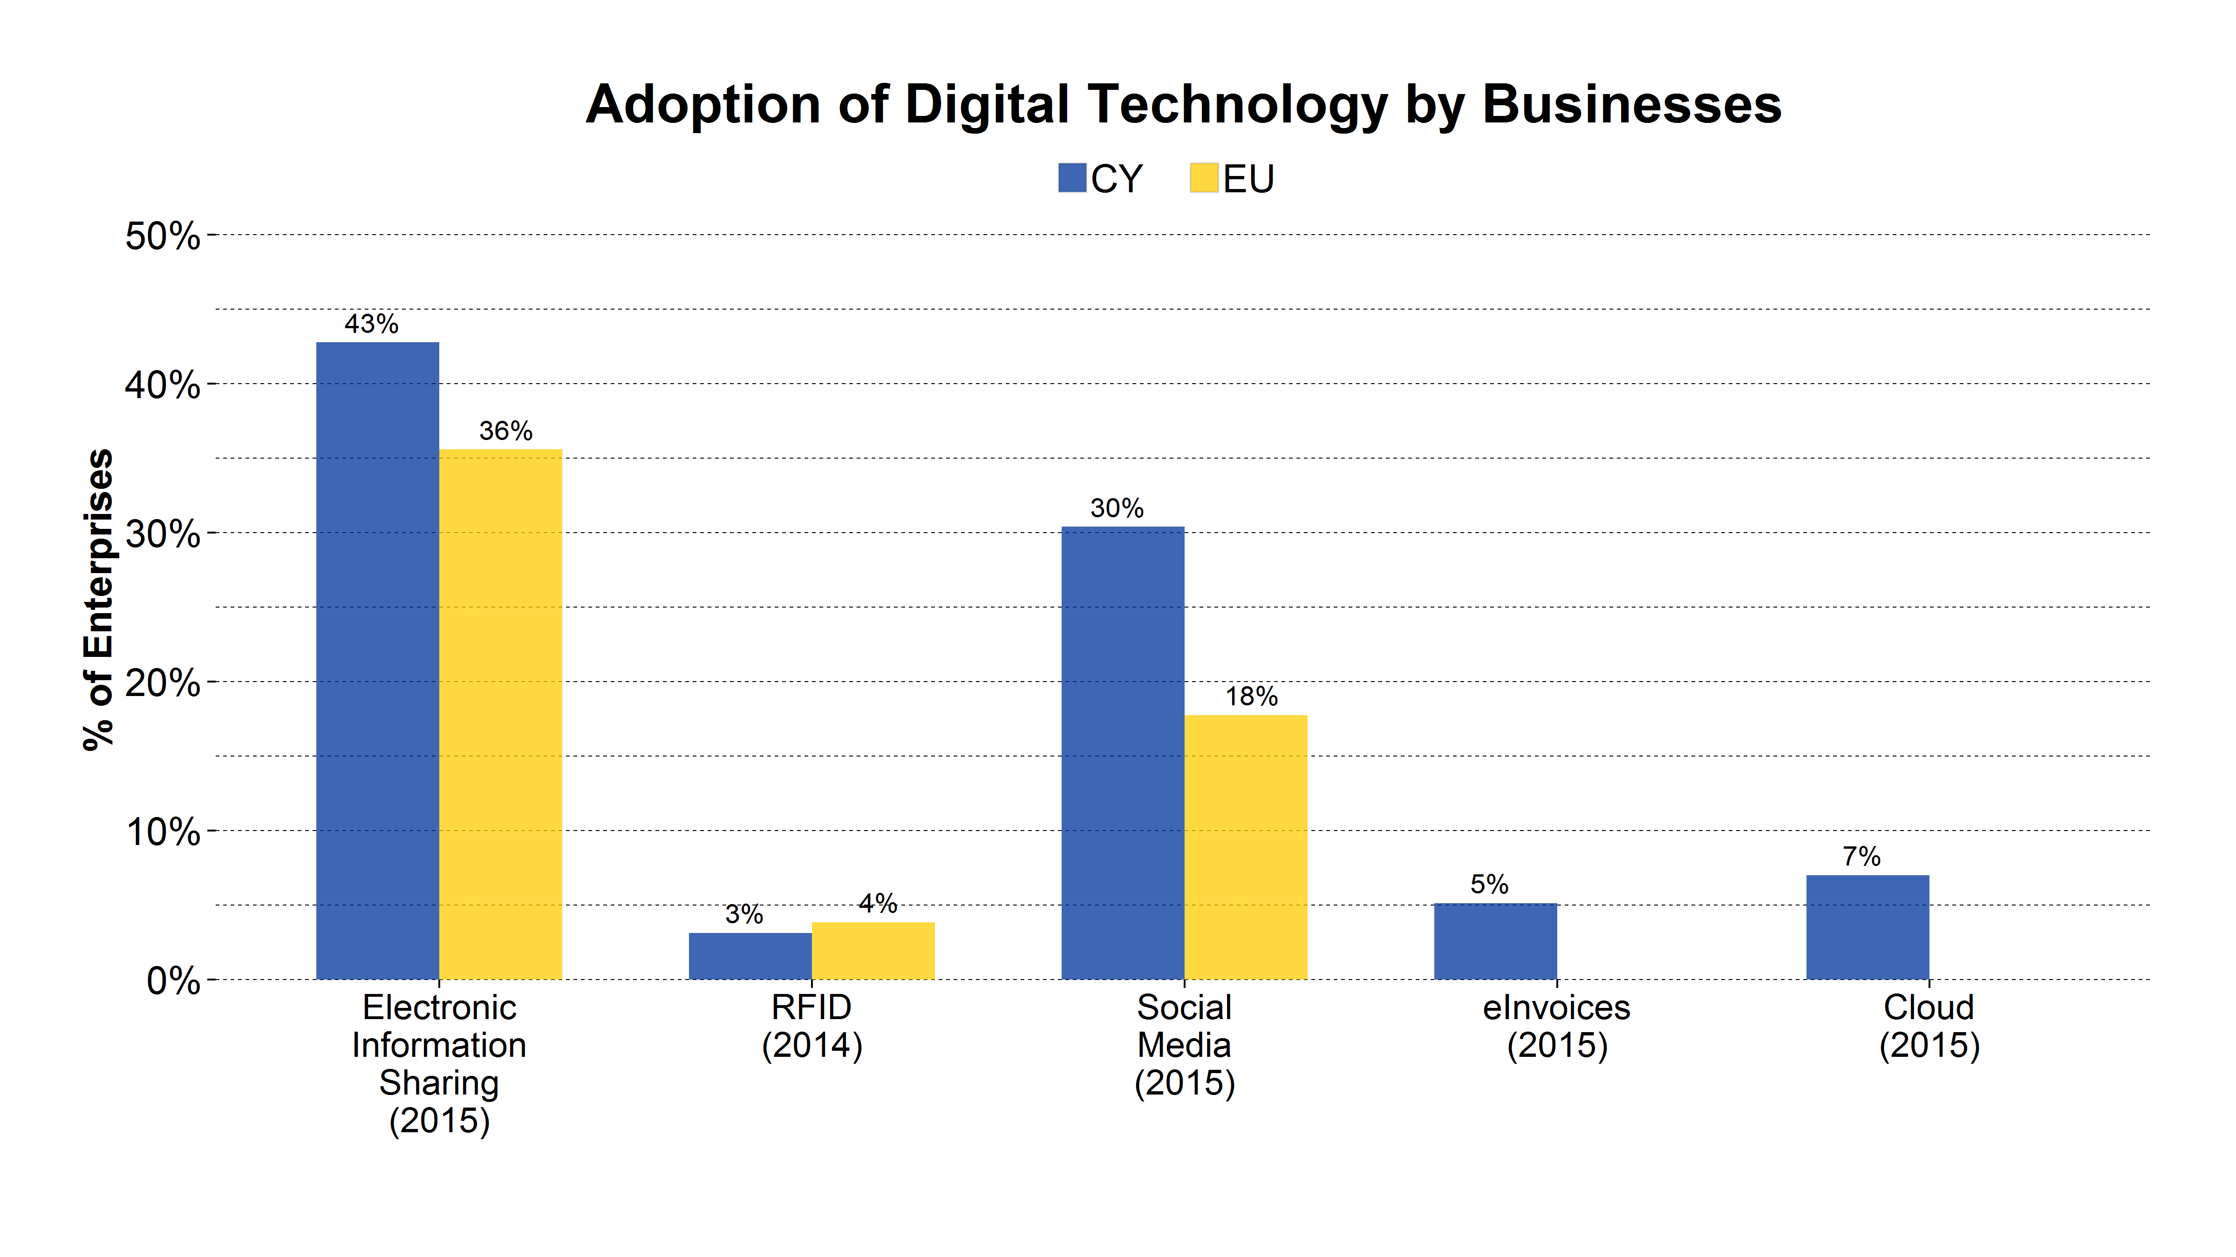
Integration of Digital Technology: Business digitization
Businesses in Cyprus are adopting different digital technologies to enhance productivity, such as sharing internal information electronically or using RFID, eInvoicing, Social Media and Cloud. Source: Eurostat - Community survey on ICT usage and eCommerce in Enterprises

Slide 15
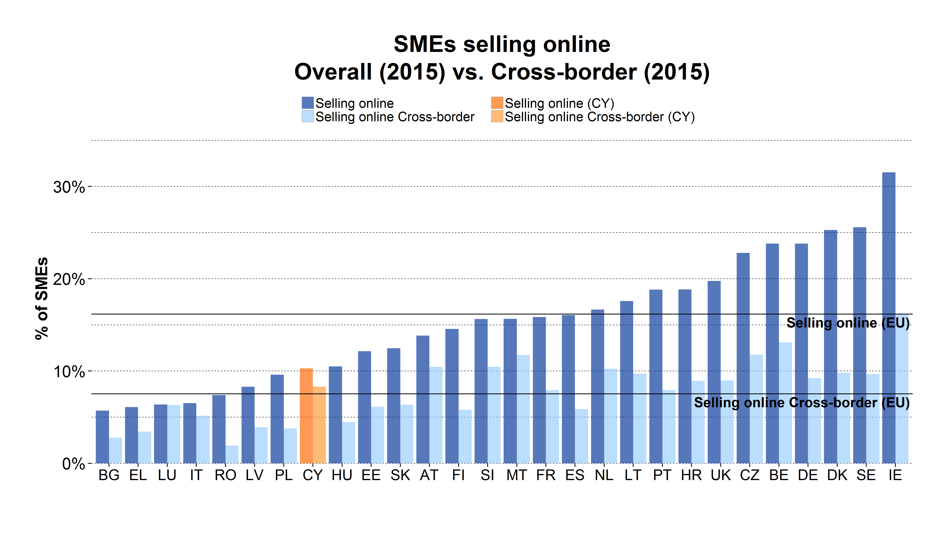
Integration of Digital Technology: SMEs selling online
In Cyprus 10% of SMEs sell online (16% in the EU). 8.3% of Cypriot SMEs sell online to other EU countries (7.5% in the EU). Source: Eurostat - Community survey on ICT usage and eCommerce in Enterprises

Slide 16
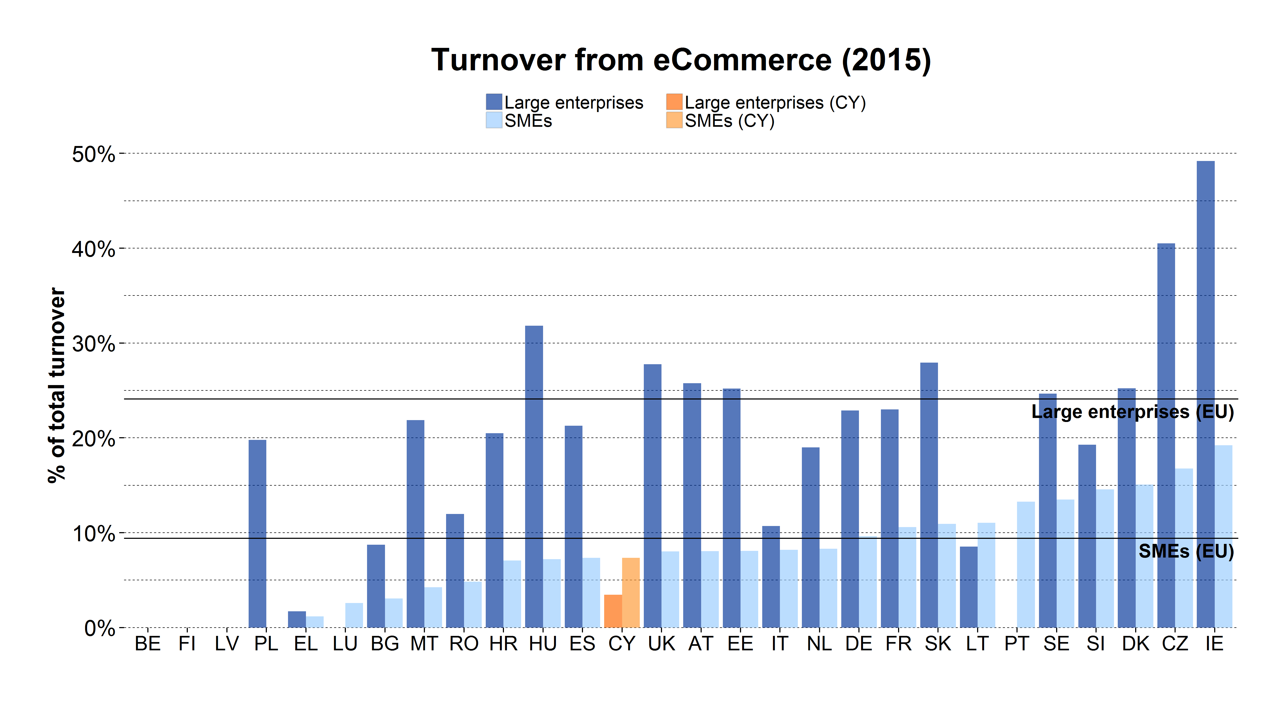
Integration of Digital Technology: SME Turnover from eCommerce
SMEs in Cyprus obtain on average 7.3% of their turnover from eCommerce (9.4% in the EU). Large enterprises derive on average 3.5% of their turnover from eCommerce (24% in the EU). Source: Eurostat - Community survey on ICT usage and eCommerce in Enterprises

Slide 17
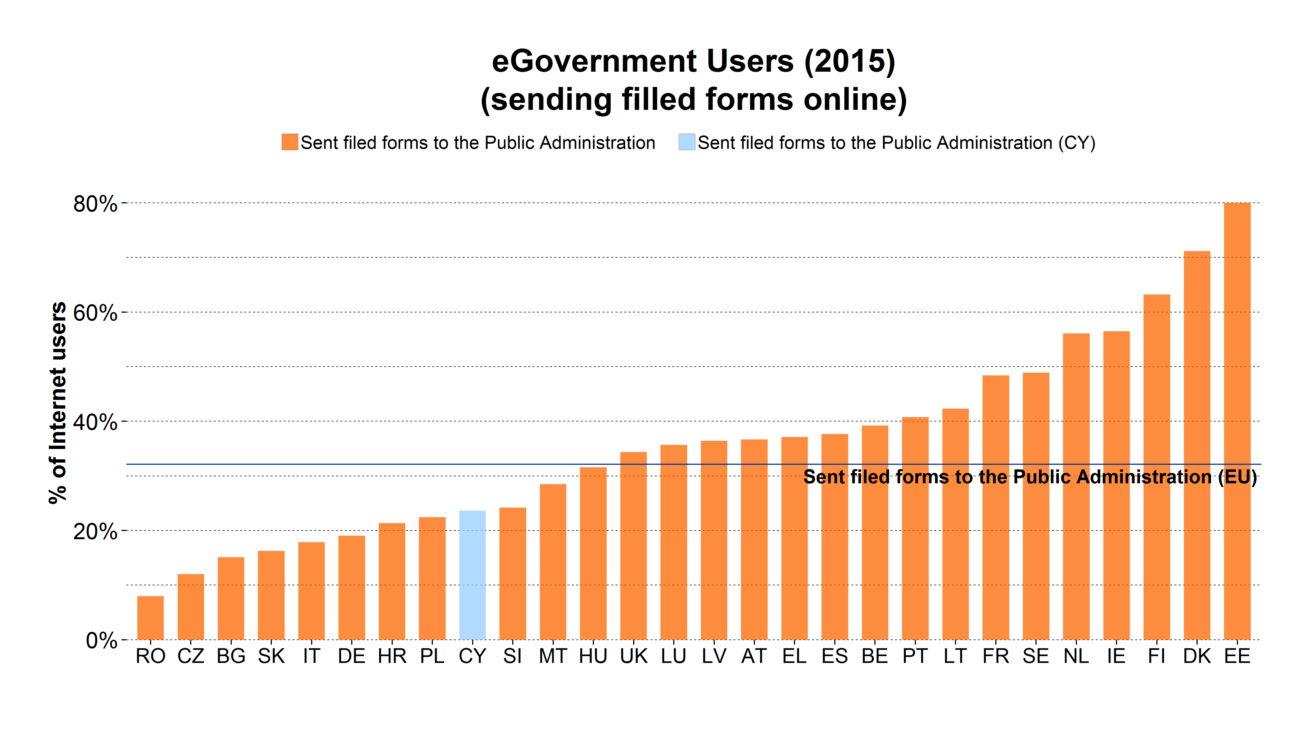
Digital Public Services: eGovernment users
24% of Cypriot internet users have exchanged filled forms with the public administration online, whereas overall in the EU 32% of internet users have done so. Source: Eurostat - Community survey on ICT usage in Households and by Individuals

Slide 18
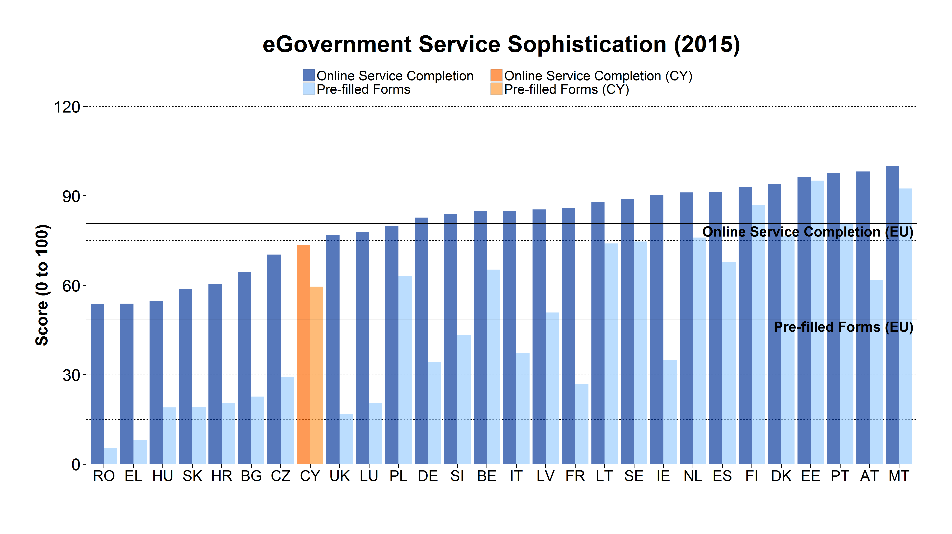
Digital Public Services: eGovernment service sophistication
Cypriot online public services score 60 out of 100 in the Pre-filled Forms* indicator and 73 out of 100 in the Online Service Completion** indicator (EU scores 49 and 81 respectively). Source: eGovernment Benchmark. * Pre-filled Forms measures to which extent data known to the public administration is pre-filled in forms presented to the user. ** Online Service Completion measures to which extent the steps in an interaction with the public administration – life event – can be performed completely online.

Slide 19
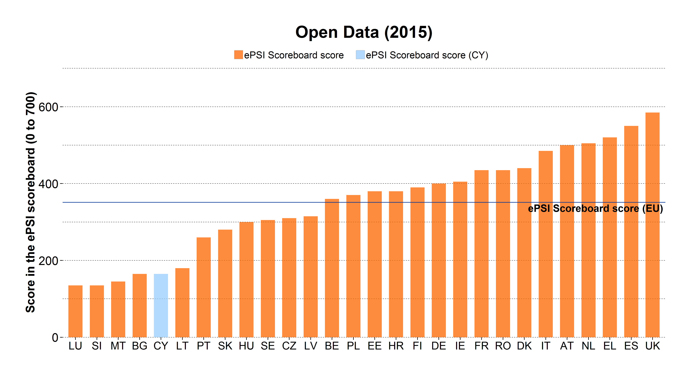
Digital Public Services: Open Data
Cyprus scores 165 out of 700 in the European Public Sector Information scoreboard, against an overall score of 351 out of 700 for the European Union. Source: The Public Sector Information Scoreboard is a ‘crowdsourced’ tool to measure the status of Open Data and PSI re-use throughout the EU.

